Slide 1
Weekly report: Machine Bed & Yaw System
Week No - 10
Date: 02.12.2025
Supervisor: Prof. Peter Quell
Shoukat Abbas, Luksh Chawla, Sathishkumar Venkatachalam, Shrihari G Kadam
Presented by – Sathishkumar Venkatachalam

Slide 2
Contents
Yaw disc / Brakes – Modification Difference
Yaw disc / Brakes finalisation
Machine Bed – Modification Difference
Machine Bed finalisation
Machine Bed – Material Cost Estimation
Updated Assembly & Status of the Work
References
Sathishkumar Venkatachalam

Slide 3
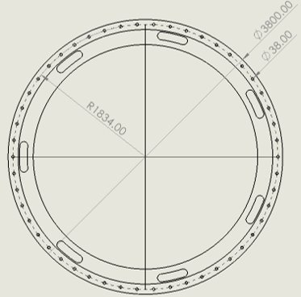
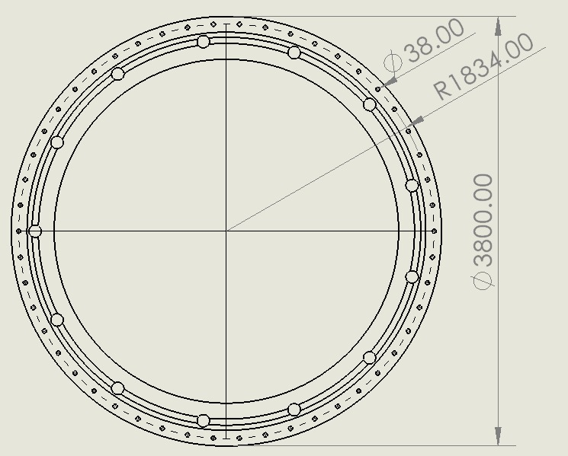
Yaw Brake – Modification Diff.
Yaw brake disk
Old 2D drawing – With Slots
Modified New Brake
Sathishkumar Venkatachalam

Slide 4
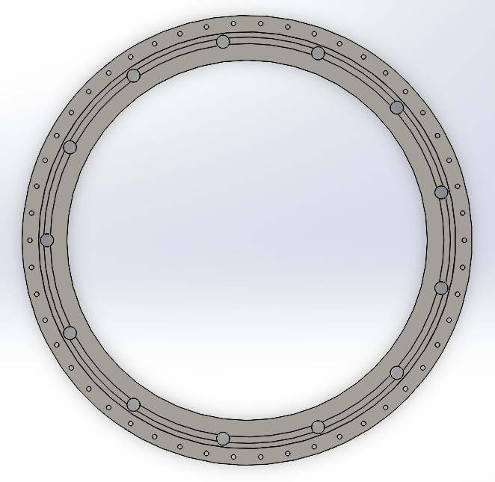
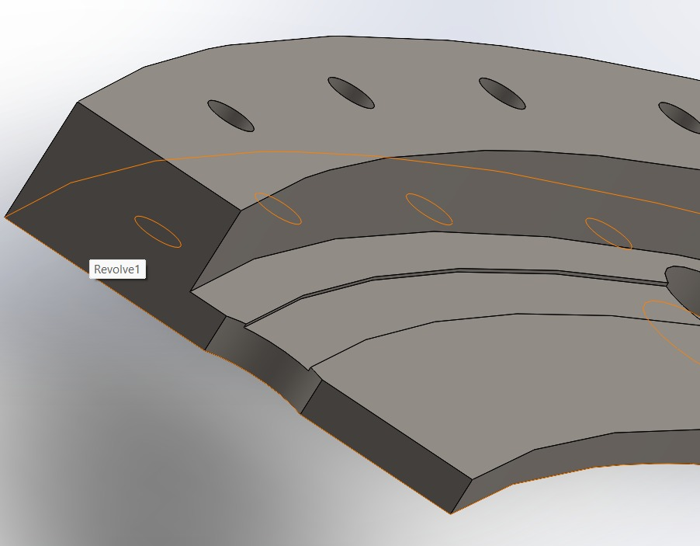
Yaw Brake Finalization
Yaw brake disk - 3D
Sathishkumar Venkatachalam

Slide 5
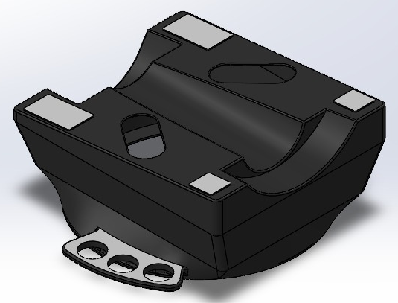
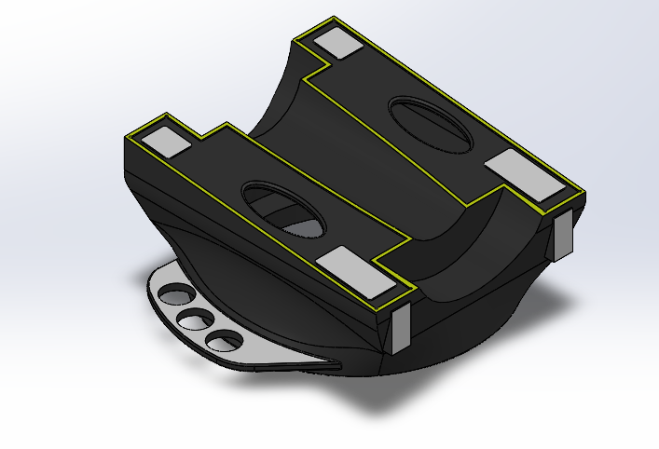
Machine Bed – Modification Diff.
Machine Bed - 3D
Sathishkumar Venkatachalam

Slide 6
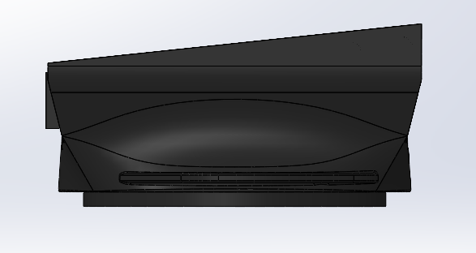
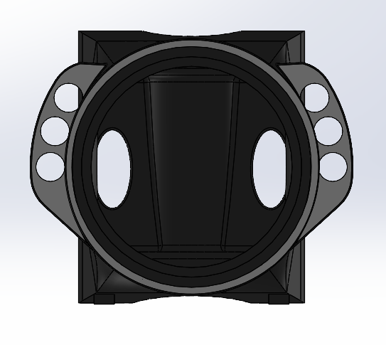
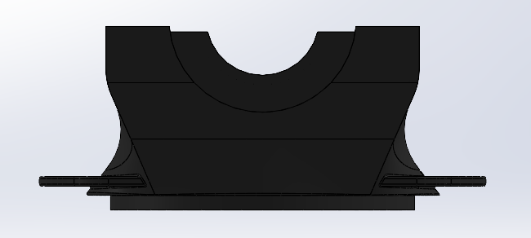
Machine Bed – Updated
Sathishkumar Venkatachalam

Slide 7
Machine Bed – Material Cost Estim.
Material: Gray Cast Iron – EN-JL-1060
Total Weight of the Machine bed: 29521.70 kilograms = 29,52 Tons
Cost per Kg of the Material = €3,15 / kg0
29521.70 kg × 3.15 €/kg = 92994€
Estimated Total Material Cost = €92994 €
[3].
Sathishkumar Venkatachalam

Slide 8
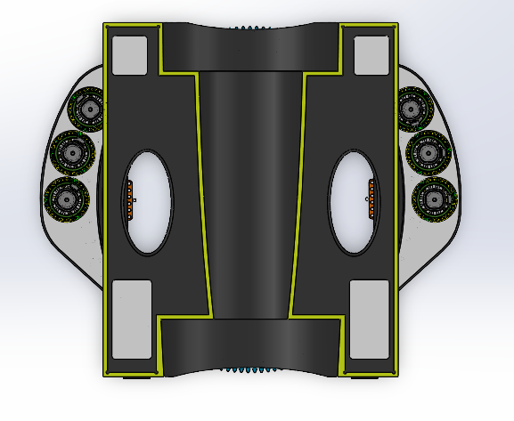
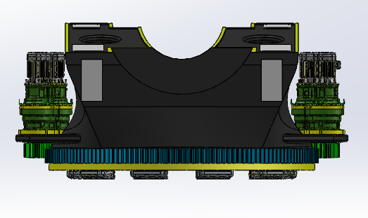
Updated Machine Bed & Yaw System Assembly
Clearance – More Than 15mm
Sathishkumar Venkatachalam

Slide 9
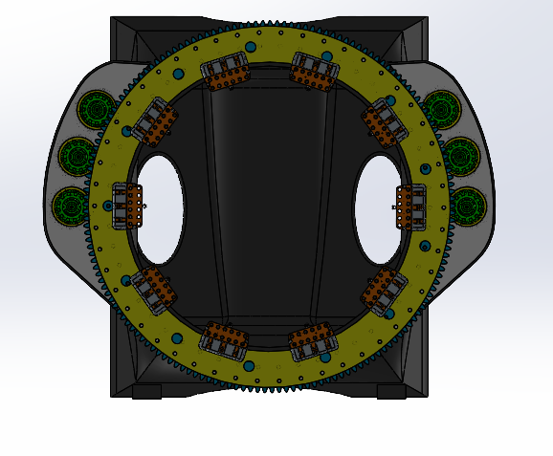
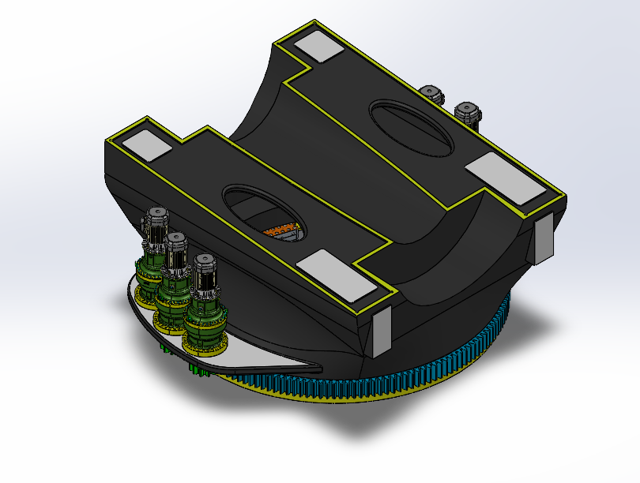
Updated Machine Bed & Yaw System Ass.
No. of yaw brake - Working on it.
Sathishkumar Venkatachalam

Slide 10
Work Status
1.Casting Bed Load Distribution – Shoukat Abbas, Sathishkumar Venkatachalam
2.Rear Welded bed - Shoukat Abbas, Sathishkumar Venkatachalam
3. Brake Disk Design – Shoukat Abbas, Sathishkumar Venkatachalam
4.Yaw brakes / System - Luksh Chawla, Shrihari G Kadam
5. Final Report - Team
Sathishkumar Venkatachalam

Slide 11
References
    [1]. Hydraulic brakes Svensborg brakes, https://www.svendborg-brakes.com/products/hydraulic-brakes/active-brakes/bsac-120/ (accessed: 13.11.2025)
    [2]. Hydraulic brakes Svensborg brakes, Svendborg-brakes /product-catalogue/ (accessed: 13.11.2025)
    [3]. For Casting Material Price -(accessed on 30.11-2025)
    https://www.gmh-gruppe.de/en/products/iron-castings/
Sathishkumar Venkatachalam

